Slide 1


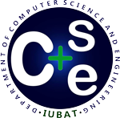
Software Maintenance and Its Value
International University of Business Agriculture and Technology
IUBAT
Prepared By: Team GEN
Supervisor
Jannatul Ferdous
Lecturer
(Department of CSE,
IUBAT)
Md Jahid Hossain
MD Arafat Sarkar
Sabir Hossain Molla
Raju Ahammed
Al Hasib Tipu
- 25303061
- 25303063
- 25303064
- 25303065
- 25303054
Department of CSE
Date: 10-11-2025

Slide 2
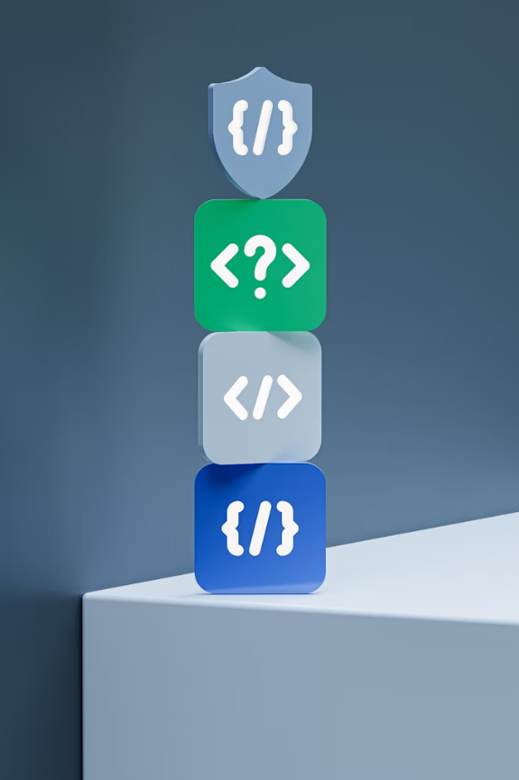
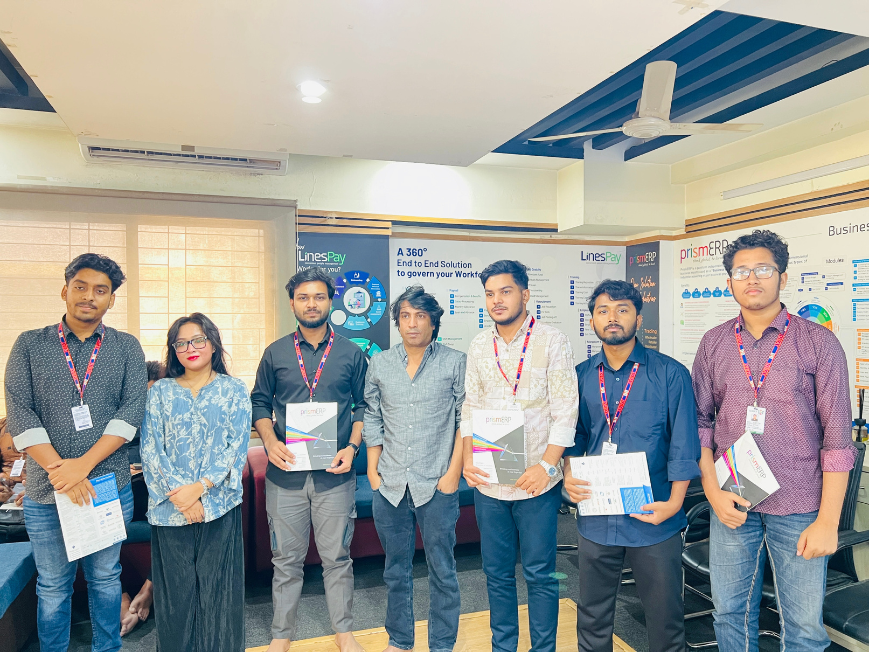
Software Maintenance & Its Value -
Project by GEN
Field study submitted to Ms Jannatul Ferdous, IUBAT. This presentation is our visit to Divine IT Limited (CMMI Level 3, ISO-certified) and a study of software maintenance: what it is, why it matters, common challenges, recommended practices, and real-world observations gathered during interviews and lab visits on 27–31 Oct 2025.

Slide 3

Abstract - Why This Study Matters
Software maintenance is the ongoing process of modifying delivered software to fix faults, improve performance, or adapt to changed environments. It consumes a major portion of lifecycle costs—often cited as up to 90%—and is therefore the most resource-intensive stage of the software lifecycle. This project uses Divine IT Limited as a case study to explore maintenance practices, tools, challenges, and strategic value.

Slide 4
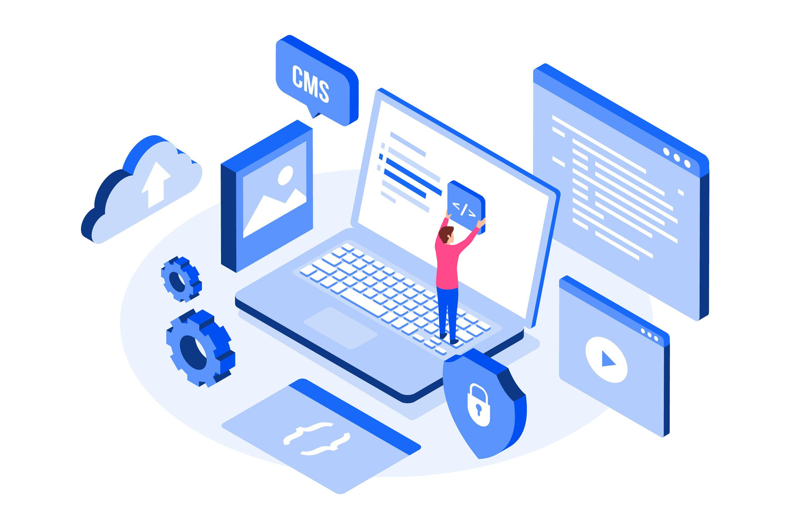
Table of Content
Introduction & Definitions
Objectives
Company Overview
Methodology
Finding
Activity Plan
Recommendations
Conclusion

Slide 5
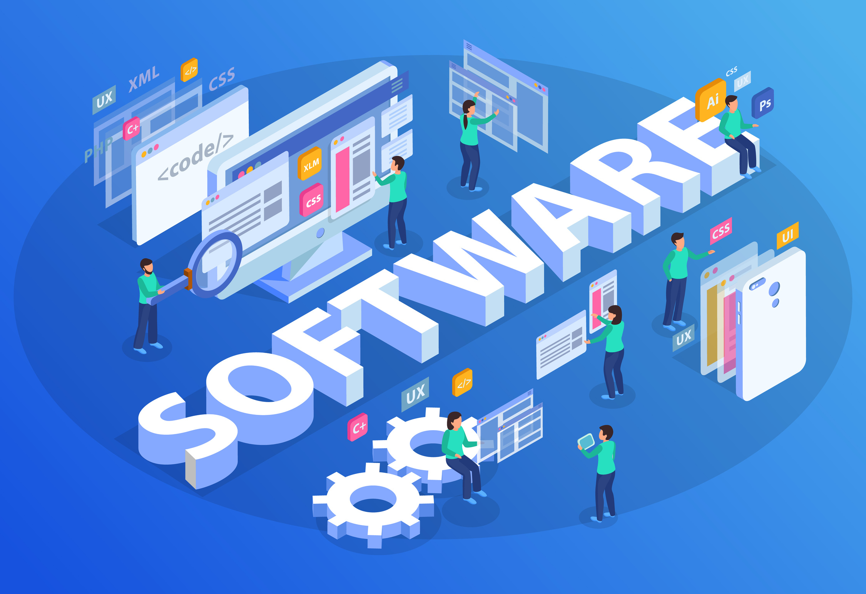
Introduction And
Software maintenance means taking care of a software system after deployment to fix errors, improve performance, adapt to new requirements, and ensure security. Per IEEE, it's a modification after delivery to correct faults, improve attributes, or adapt to a modified environment. This extends beyond bug fixes to upgrades, optimization, and long-term sustainability.
Definitions
01
02
Software Update
Error Fix
Versions might expose your device to hacks. Find and update them with ease.
A software error fix, or patch, involves modifying code to resolve a defect or bug.

Slide 6



Key Report
Objective
Define Software Maintenance Value
Grasp the concept and essential role of software maintenance in ensuring systems are effective, reliable, and durable.
The concept and critical importance of software maintenance for system longevity, covering the four types (corrective, adaptive, perfective, and preventive), and linking this theory to real-world practices, challenges, and tools observed during a visit to an IT firm to highlight its value in supporting business and ensuring long-term software sustainability.
Analyze Maintenance Types
Study the four classifications: corrective, adaptive, perfective, and preventive.
Bridge Theory and Practice
Gain practical exposure by observing real-world maintenance activities and processes at an IT firm.

Slide 7
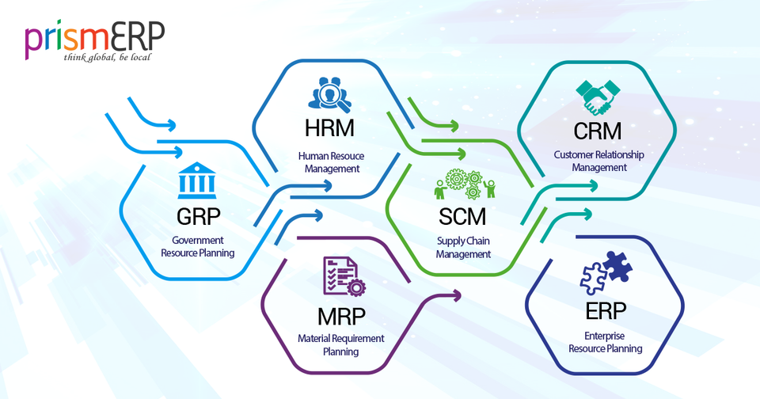
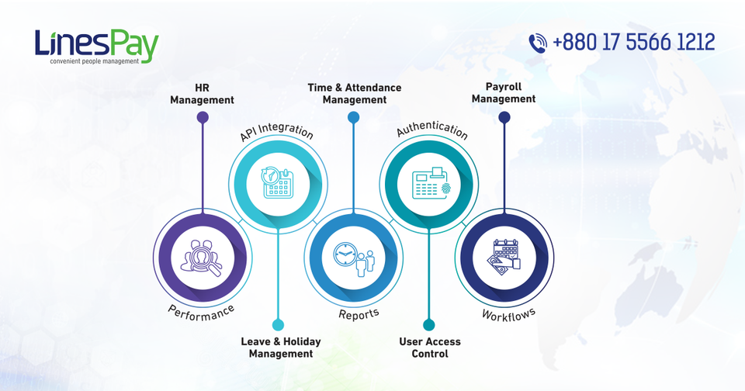
Company Overview - Divine IT Limited
Founded in 2005, Divine IT Limited is an award-winning provider of web & mobile solutions, ERP, and integration services. The firm holds CMMI Level 3, ISO 27001:2013, and ISO 9001:2015 — demonstrating mature processes, information security, and quality management.
PrismERP
LinesPay
Platform-independent ERP used by 400+ businesses across 65 industry types for centralised operations and cross-department workflows.
Comprehensive HR & payroll system covering attendance, payslips, loans, allowances, and advanced reporting.

Slide 8
Services,
Technologies & QA
Core services include custom app development, web & e-commerce, mobile apps, ERP consultancy, storage & backup, physical security, managed support, system integration, and data center solutions. Maintenance relies on a diverse tech stack, version control, CI/CD, automated testing, and QA labs to ensure reliability and performance.
Key Technologies
Quality Assurance
Version Control (Git)
CI/CD pipelines & staging environments
Automated testing frameworks
Dedicated QA/testing labs
Regression & performance testing
Security testing & ISO-aligned controls

Slide 9
Types of
Defines four main maintenance types.
Software Maintenance
01
Corrective
02
Adaptive
Fixes faults and bugs reported after release — reactive maintenance to restore functionality.
Adapt software to new environments (OS, hardware, third-party APIs) to keep compatibility.
03
Perfective
04
Preventive
Enhances performance, usability, or features based on user feedback and evolving needs.
Proactive refactoring, documentation updates, and optimisations to reduce future faults and technical debt.

Slide 10
Methodology
The main objectives of this research are twofold: first, to carefully document the specific maintenance protocols and organisational methods used by the firm, and second, to develop modern software.
A Blended Approach to Data Collection
01
Primary Data Collection
Secondary Data Collection
02
Focused on gathering specific, firsthand data directly from the case study subject, Divine IT Limited, ensuring contextual relevance.
By the help of our seniors.
Collecting information from books and the internet.
With group discussion.

Slide 11



Findings -
Challenges & Observations
Our field visit and interviews highlighted common maintenance challenges and their operational impacts observed at Divine IT Limited and in industry practice.
Technical Debt & Resource Limits
Incomplete or outdated docs make diagnosis and fixes slower and riskier.
Poor Documentation
Shortcuts during development lead to debt; often, fewer budget and staff are allocated to maintenance.
Legacy Code
Old technologies and complex codebases require specialised skills and increase maintenance costs.

Slide 12



Activity Plan
Five-day field activity focused on planning, organisation selection, site visits, report writing, and presentation preparation. Based on findings, we propose operational and technical recommendations to improve maintenance outcomes.
PLAN & DISCOVER
Day 1-2: Identify problems and select organisations to visit.
VISIT & OBSERVE
Day 3: On-site visits, interviews with the Founder and Management.
REPORT & PRESENT
Day 4-5: Compile findings, write report, and prepare presentation

Slide 13
Reccommendations
Top Recommendations
Keep software updated.
Test after every update.
Use Git for version control.
Check system compatibility.
Fix security issues.
Backup data before maintenance.
Use Git for version control.
8. Remove unused code.
9. Follow coding standards.
10. Check performance logs.

Slide 14



Conclusion & Next Steps
Maintenance is a strategic, ongoing function essential for security, performance, compatibility, and user satisfaction. Prioritising maintenance—through documentation, automation, testing, and resource allocation—reduces long-term costs and preserves software value. Next steps: adopt the recommended practices, allocate maintenance budgets, and monitor outcomes via metrics and regular audits.
Immediate
Strategic
Engagement
Start automated backups, enforce Git workflows, and schedule regression tests after each change.
Invest in refactoring legacy code, staff training, and CI/CD to lower technical debt over time.
Collect user feedback and measure satisfaction to guide perfective maintenance priorities.

Slide 15
Any Question?

Slide 16
Thank You
Everyone 😊
Team - Gen

